Slide 1

Predicting House Prices in Bangalore
Exploring the use of machine learning techniques to accurately assess and forecast home values in Bangalore's dynamic real estate market.

Slide 2

Aim
The aim of this project is to build a machine learning model to predict home prices in Bangalore. It compares different regression models and fine-tunes them using GridSearchCV to find the best one. The goal is to make accurate price predictions based on property features.
Dataset
Area type, society, location, size, total_sqft, bath, balcony, price

Slide 3

Data Cleaning
Removing duplicates and irrelevant records to improve data quality.
Handling Missing Values
Using imputation or removal methods to address gaps in the dataset.
Feature Engineering
Creating new features from existing data to enhance model performance.
Normalization and Scaling
Adjusting data ranges to ensure consistent input for algorithms.
Encoding Categorical Variables
Transforming non-numeric data into numeric formats for model compatibility.
Outlier Detection
Identifying and addressing anomalies that may skew results.

Slide 4

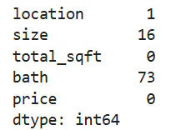
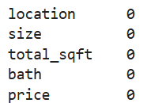
Here we observe that there is multiple NaN values in this data set
/
Handling Missing Values
Now here we just drop those NaN Values

Slide 5
1. Add new feature(integer) for BHK (Bedrooms Hall Kitchen).
2. Use the average for ranges, and remove complicated cases.
3. Add new feature called price per square feet.
/
Feature Engineering
s

Slide 6
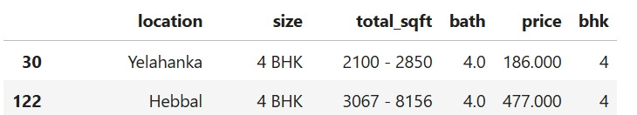
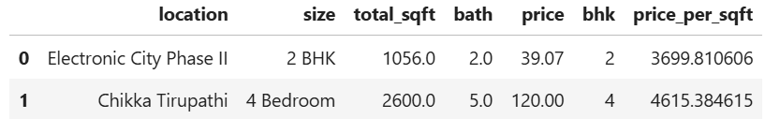
Before
After

Slide 7
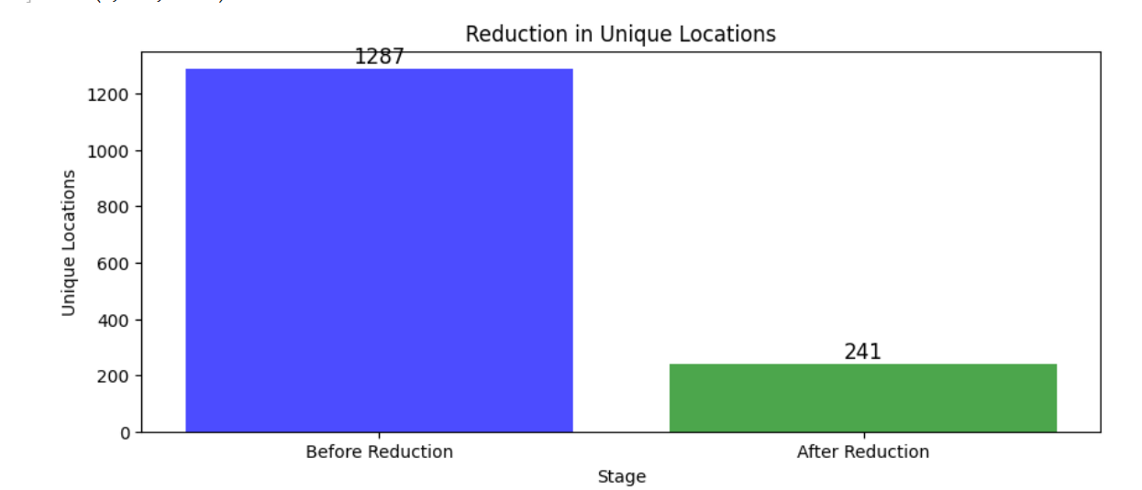
Dimensionality Reduction
/
Locations with less than 10 data points are grouped as "other" to reduce categories.
Later on when we do one hot encoding, it will help us with having fewer dummy columns.

Slide 8

Outlier Removal
1. Using Business Logic
2. Using Standard Deviation And Mean
3.Using Bathrooms Feature

Slide 9
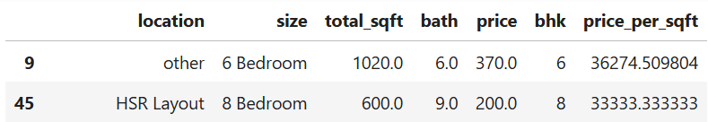
/
Using Business Logic
We have 6 bhk apartment with 1020 sqft. Another one is 8 bhk and total sqft is 600, it is considered unrealistic. These are clear data errors that can be removed safely.
s.

Slide 10
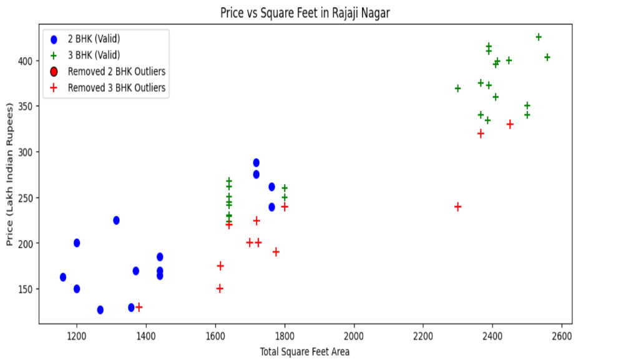
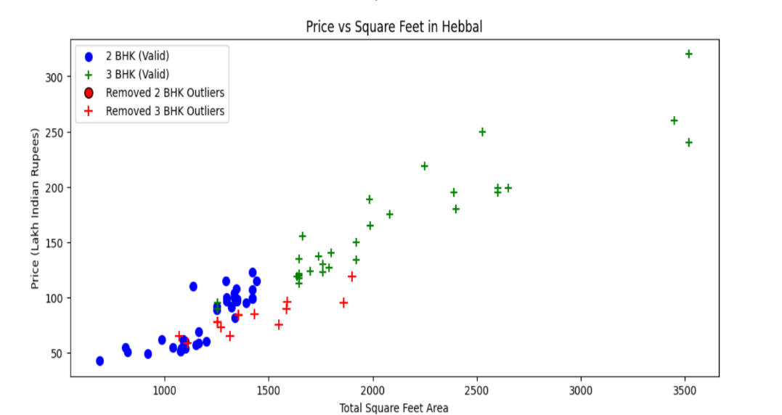
Using Standard- Deviation and Mean
1.Property prices range from ₹267/sqft to ₹1,20,000/sqft, showing big variations. We remove properties with prices too far from the average.
2. Now we can remove those 2 BHK apartments whose price_per_sqft is less than mean price_per_sqft of 1 BHK apartment.

Slide 11
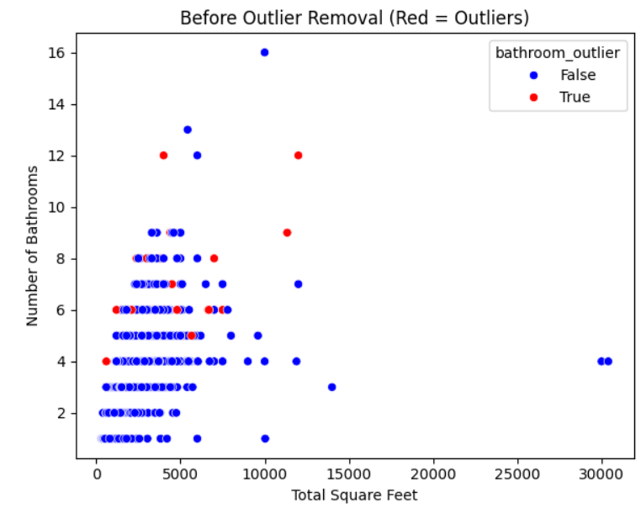
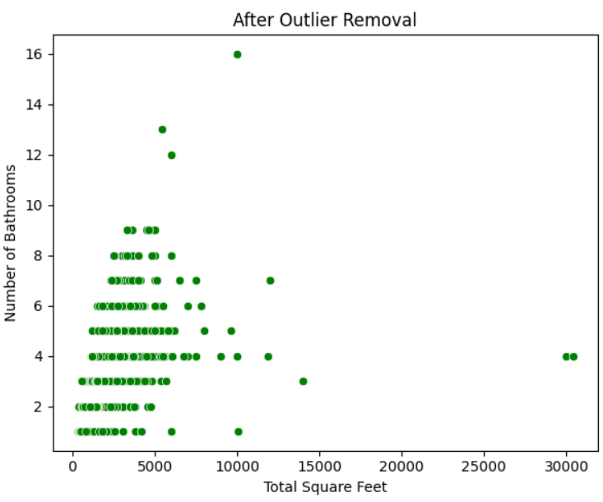
Using Bathrooms Feature
1.It is unusual to have 2 more bathrooms than number of bedrooms in a home.
2. Homes should have at most 1 extra bathroom than bedrooms (e.g., 4 BHK → max 5 baths). Anything above that is an outlier or a data error and can be removed.

Slide 12
Encoding Categorical Variables
We convert location names into numbers using One-Hot Encoding. This helps the model understand locations better. For example, instead of text like "Indiranagar" or "Whitefield", we create separate columns with 1s and 0s to represent each location. This makes the data suitable for machine learning.

Slide 13
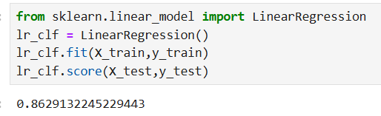
Build a Model
Splitting Data:
Training data (80%)
Testing data (20%)
Training the Model:
We use Linear Regression, a method that finds the best straight-line relationship between input features (like location, size, etc.) and house price.
Evaluating Accuracy: here we get 86% accuracy
/

Slide 14
Measure accuracy of our LinearRegression model
/
Evaluating Accuracy: -
We used K-Fold Cross Validation to measure the accuracy of our Linear Regression model ,By using ShuffleSplit, we split the data into 5 different training and testing sets.
Get a score above 80% all the time.

Slide 15

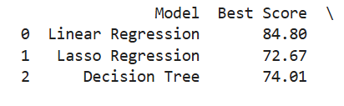
We used GridSearchCV to test different regression models (Linear Regression, Lasso, and Decision Tree Regressor).
The method tested each model multiple times using ShuffleSplit cross-validation.
the results, we found that Linear Regression performed the best.
Find best model using GridSearchCV
/

Slide 16
The HTML (Hypertext Markup Language )file contains a form with the following input fields: -
Total Square Feet
BHK (Bedrooms Hall Kitchen))
Bathrooms
Location
A "Predict Price" button to submit the form.
The CSS (Cascading Style Sheets)file defines the styling for the application, including: -
A background image of a property.
A clean white container for the form with rounded corners and shadow effects.
Styling for form elements (inputs, select dropdown, and button).
Green-colored submit button with hover effects.
A result box section to display the predicted price.
/
Web Interface

Slide 17
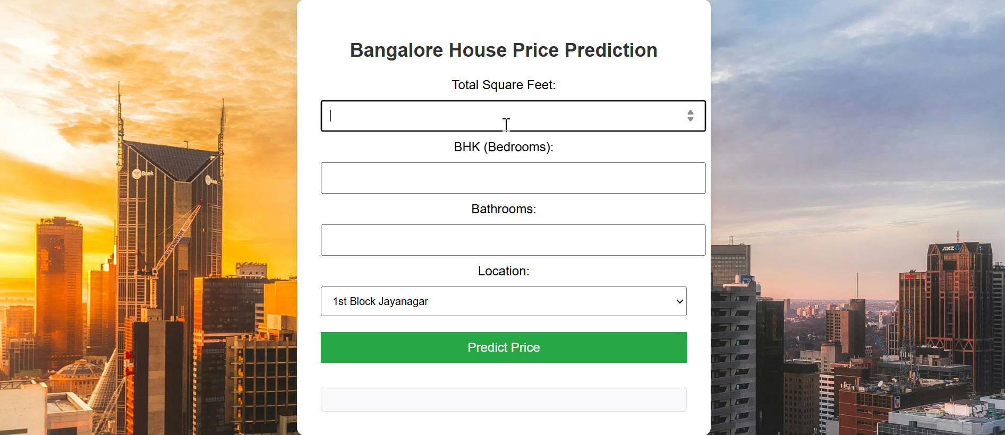
Test the model for few properties

Slide 18
THANK YOU !
Dhruv Kumar – 2229030
Ayam Singh – 2229023
Ankesh Manna – 2229012
Arko Priyo Nandi - 2229017

